Slide 1


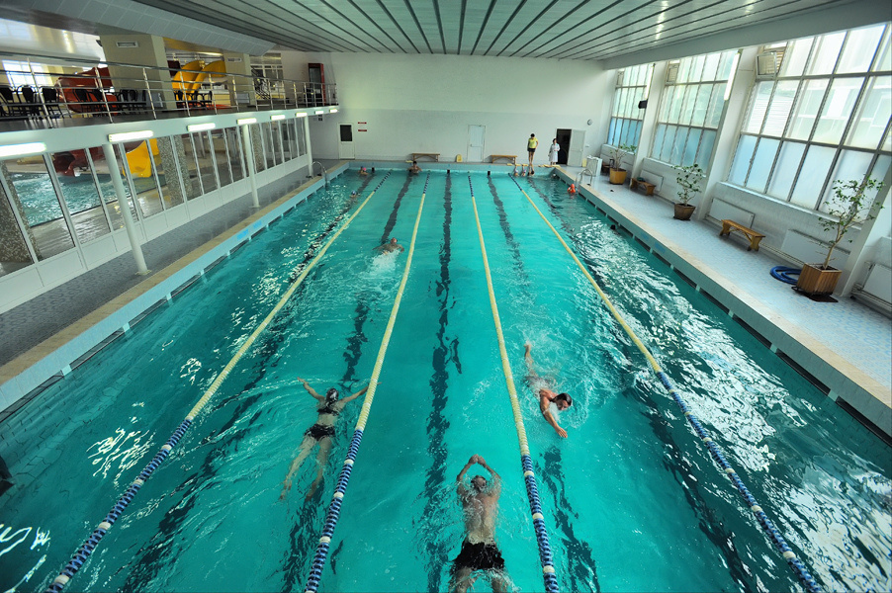
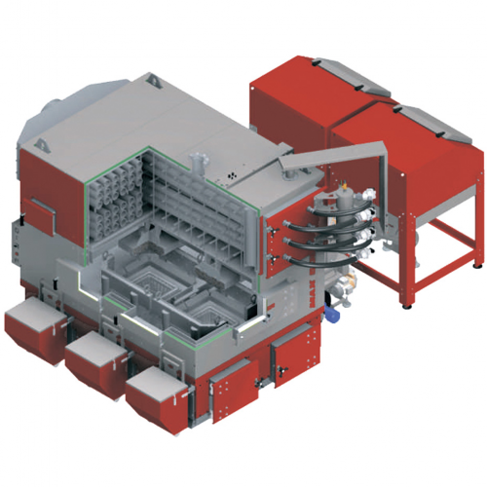



Reconstruction of a boiler house with installation of a solid fuel boiler at 5 St. Luka Street

Slide 2

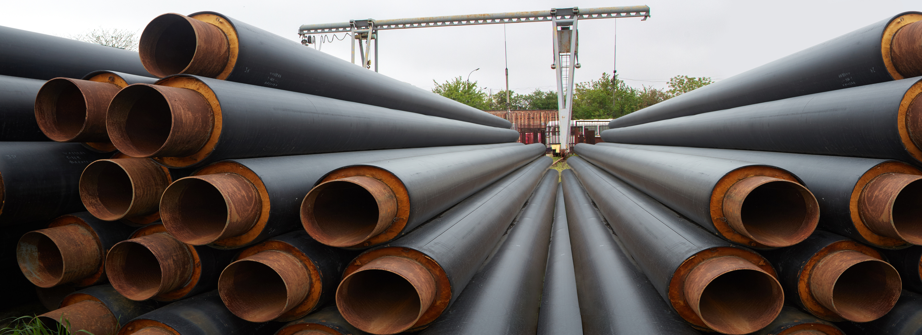






Reconstruction of a boiler house with installation of a solid fuel boiler at 5 St. Luka Street
The project includes the following works:
purchase of equipment
installation of equipment
commissioning
thermal capacity: 2.5 MW
The total cost of the project is
≈ 600 000 €

